Slide 1
Ggplot2 and interactive graphics with R
Christophe Ladroue
SECTION 07
VIDEO 04
Downloading a file
www.PacktPub.com

Slide 2
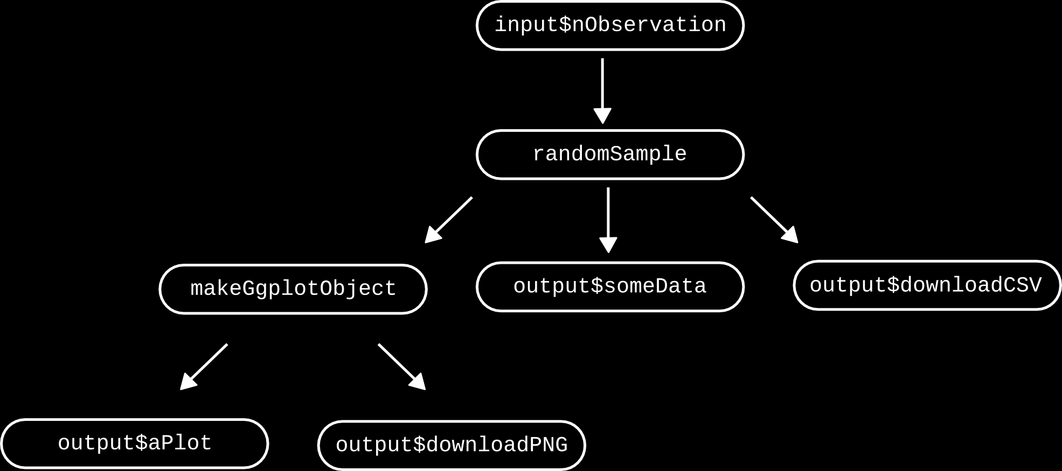
Reactive programming at work

Slide 3
In this video we took a look at
how to make it possible for the user to download results from the webpage, either in a text file or a binary file.
Next: publishing your work

Slide 4
In this section we’re going to take a look at
Creating and using tabs.
Understanding scoping.
Uploading a file.
Downloading a file.
Sharing your work.

